Slide 1
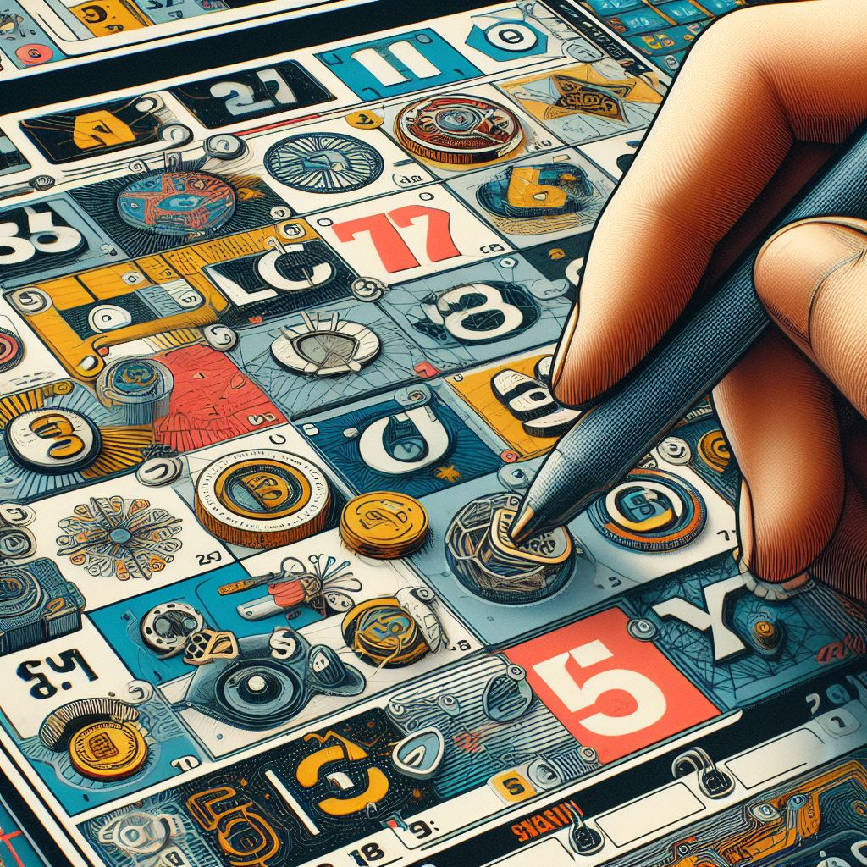
LOTTERY GAME
A Project made by Python.

Slide 2
ABOUT THE PROJECT
01
GAME FEATURES
02
TABLE OF CONTENTS
THE GAMEPLAY
03
PROJECT STAGES
04
CONCLUSION
05
A simple and light Lottery game based on Random number generation.
The usefull features our Project promises
The rules and playthough of our game.
The stages our project has went through for completion.

Slide 3


OUR MEMBERS
This group project was the unified work of:
Nehar kr. Roy
Debasish Chowdhury
Angshu Ghosh

Slide 4
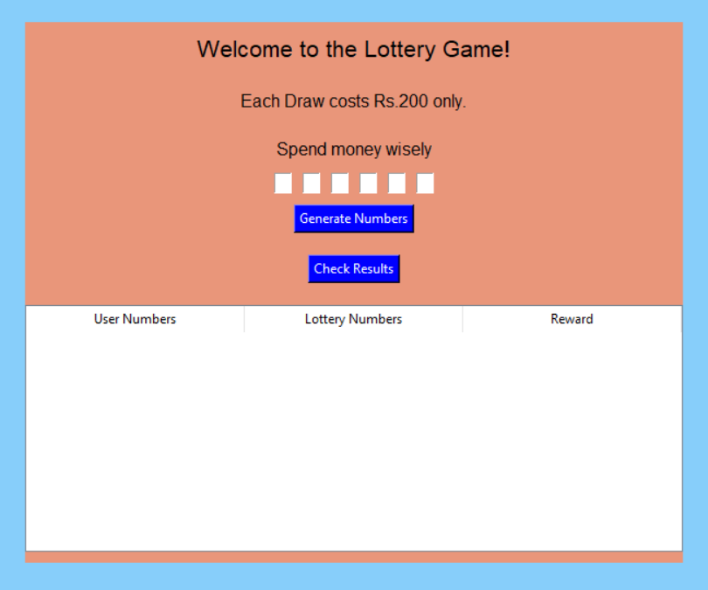
ABOUT THE PROJECT
In this presentation, we’ll explore a straightforward Python program that simulates a lottery game. The game allows players to select numbers, generates a random winning combination, and determines whether the player wins or loses.

Slide 5


GAME FEATURES

Slide 6
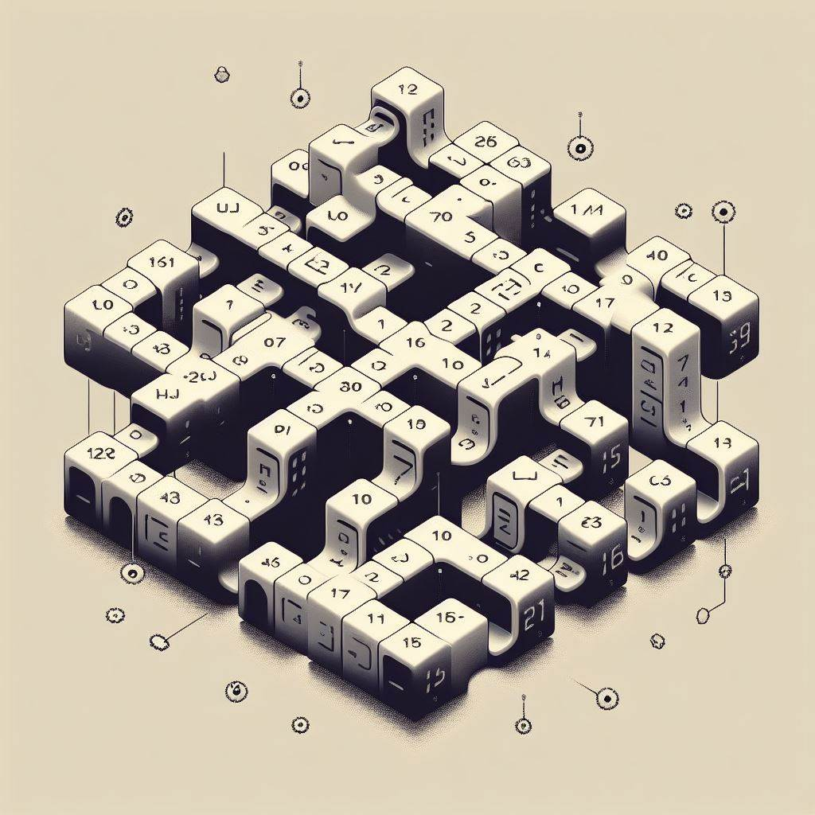
User Interaction:
Game Features
Random Number Generation:
Winning Logic:
VENUS
Feedback:
Players can input their chosen numbers.
The program generates a random winning combination.
The player’s numbers are compared to the winning combination to determine the outcome.
Venus has a beautiful name and is the second planet from the Sun. It’s terribly hot
The program provides feedback on whether the player wins or loses.

Slide 7

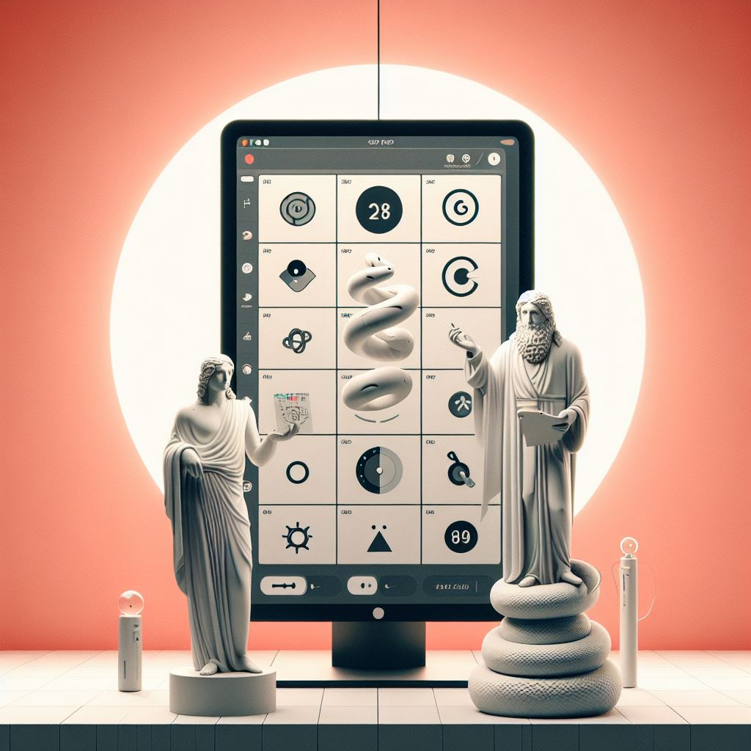
Welcome Page
The Gameplay
Generate Numbers and Results Pages
The code initializes a graphical user interface (GUI) using the tkinter library.
Upon launching, players are greeted with a welcome page featuring an ASCII art design and a “Start” button to begin the lottery game.
The game progresses to a “Generate Numbers” page where random numbers can be generated (though this functionality isn’t fully implemented yet).
Finally, there’s a “Results” page that would eventually display the outcome of the lottery game based on user input and random number generation.

Slide 8
Raw code
Adding GUI
PROJECT STAGES
Adding Welcome page
ASCII Art
The first Step was determining the Raw code for the Game
Our next step was using tkinter to add a simple UI to our code
Then We decided to add a welcome page for making it more interactive
Finally we added Ascii art for more Sophisticated look.

Slide 9
Conclusion.
Concluding
Our work
In conclusion, this Python script offers a straightforward and interactive lottery gaming experience through a user-friendly Tkinter interface. It successfully combines random number generation, user input validation, and results display, providing an engaging and visually appealing application. The code's structure promotes clarity and maintainability, making it a suitable starting point for further enhancements or modifications to the lottery game.

Slide 10
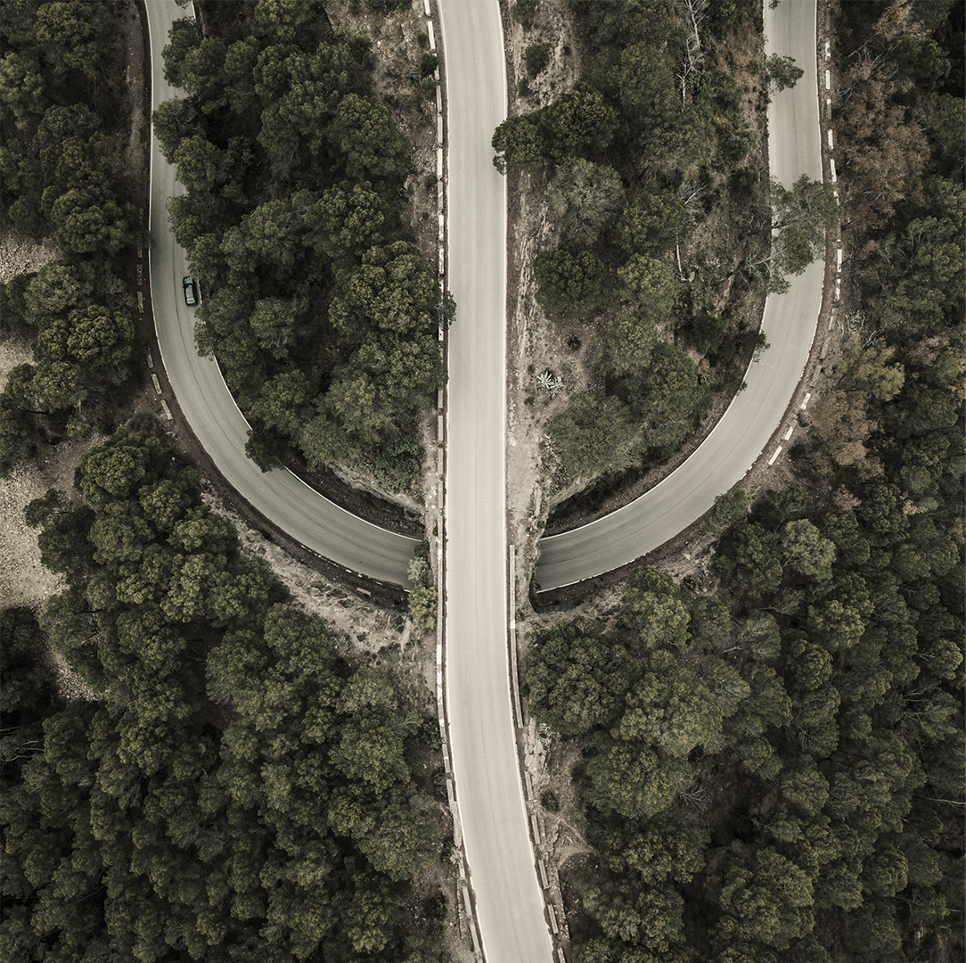
THANKS
Credits-
Images Used from Gpt 3.5
Lottery game inspired by -https://github.com/topics/guessing-number-game?l=python

